Slide 1
Nebula Insight

Slide 2
Goal
Extract data
Provide Insights

Slide 3
Tools
Python
SQLAlchemy → Database
Large Language Model → NER

Slide 4
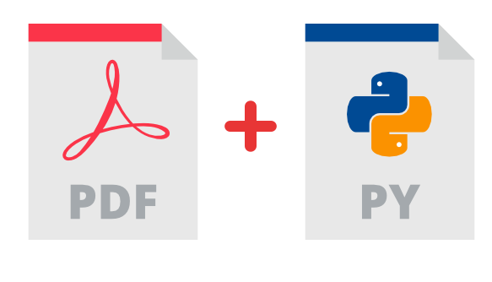
Python

Slide 5

SQLAlchemy

Slide 6
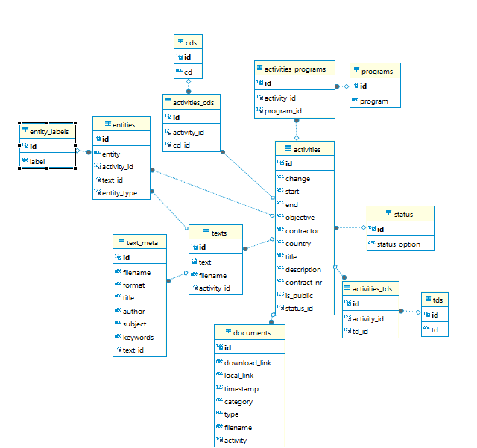

Slide 7
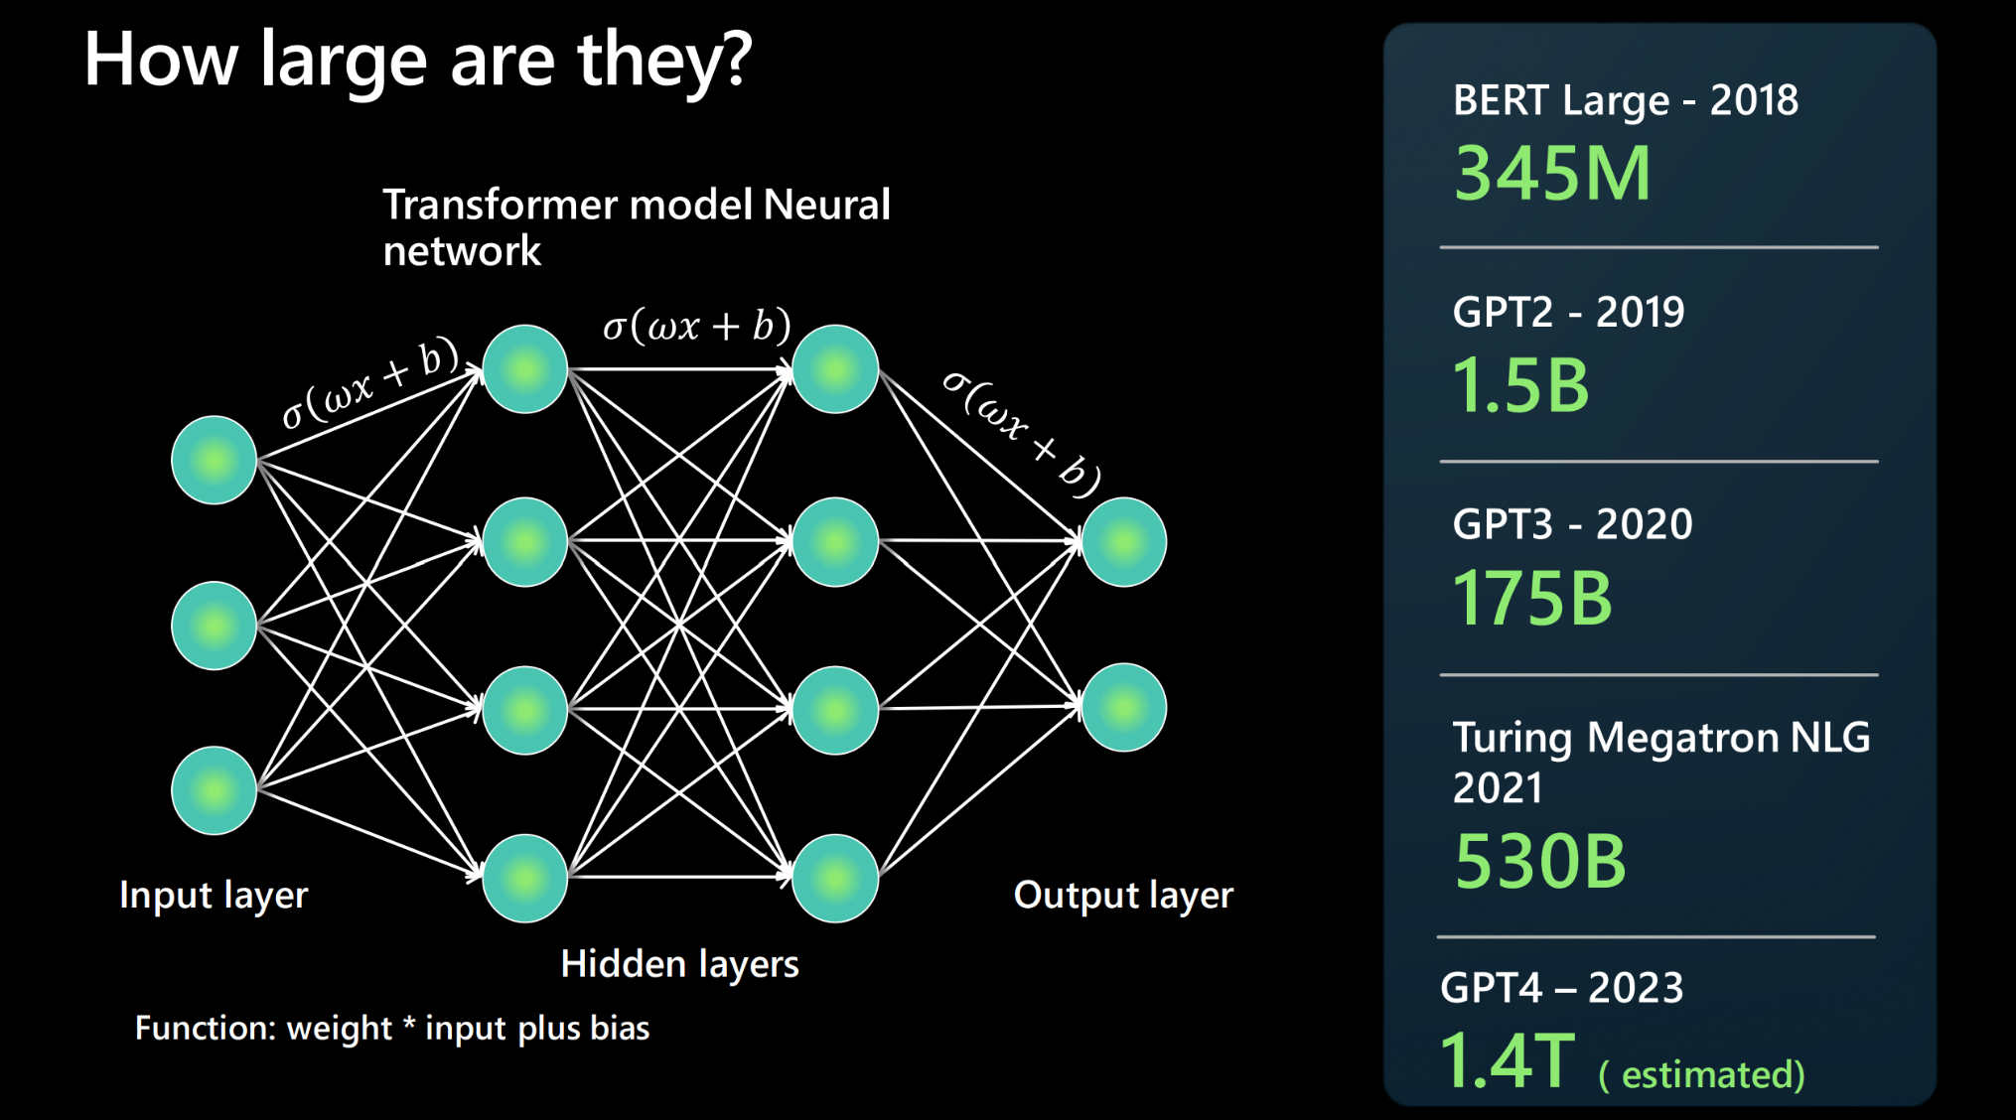
Large Language Model (LLM)

Slide 8


BERT

Slide 9
Data
spaCy → Python Package
Entity: Lessons Learned
Labels: PERSON

Slide 10
Data
spaCy → Python Package
Entity: Lessons Learned
Labels: ACTIVITY

Slide 11
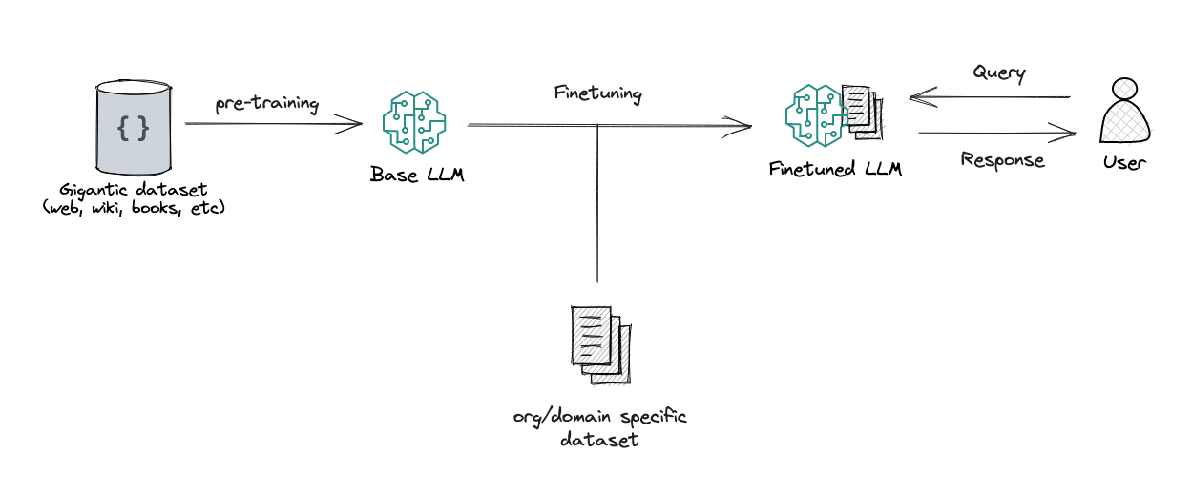

Slide 12
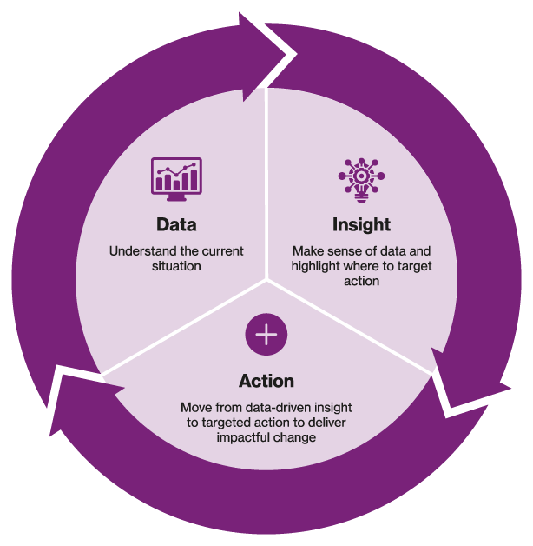
Benefits

Slide 13
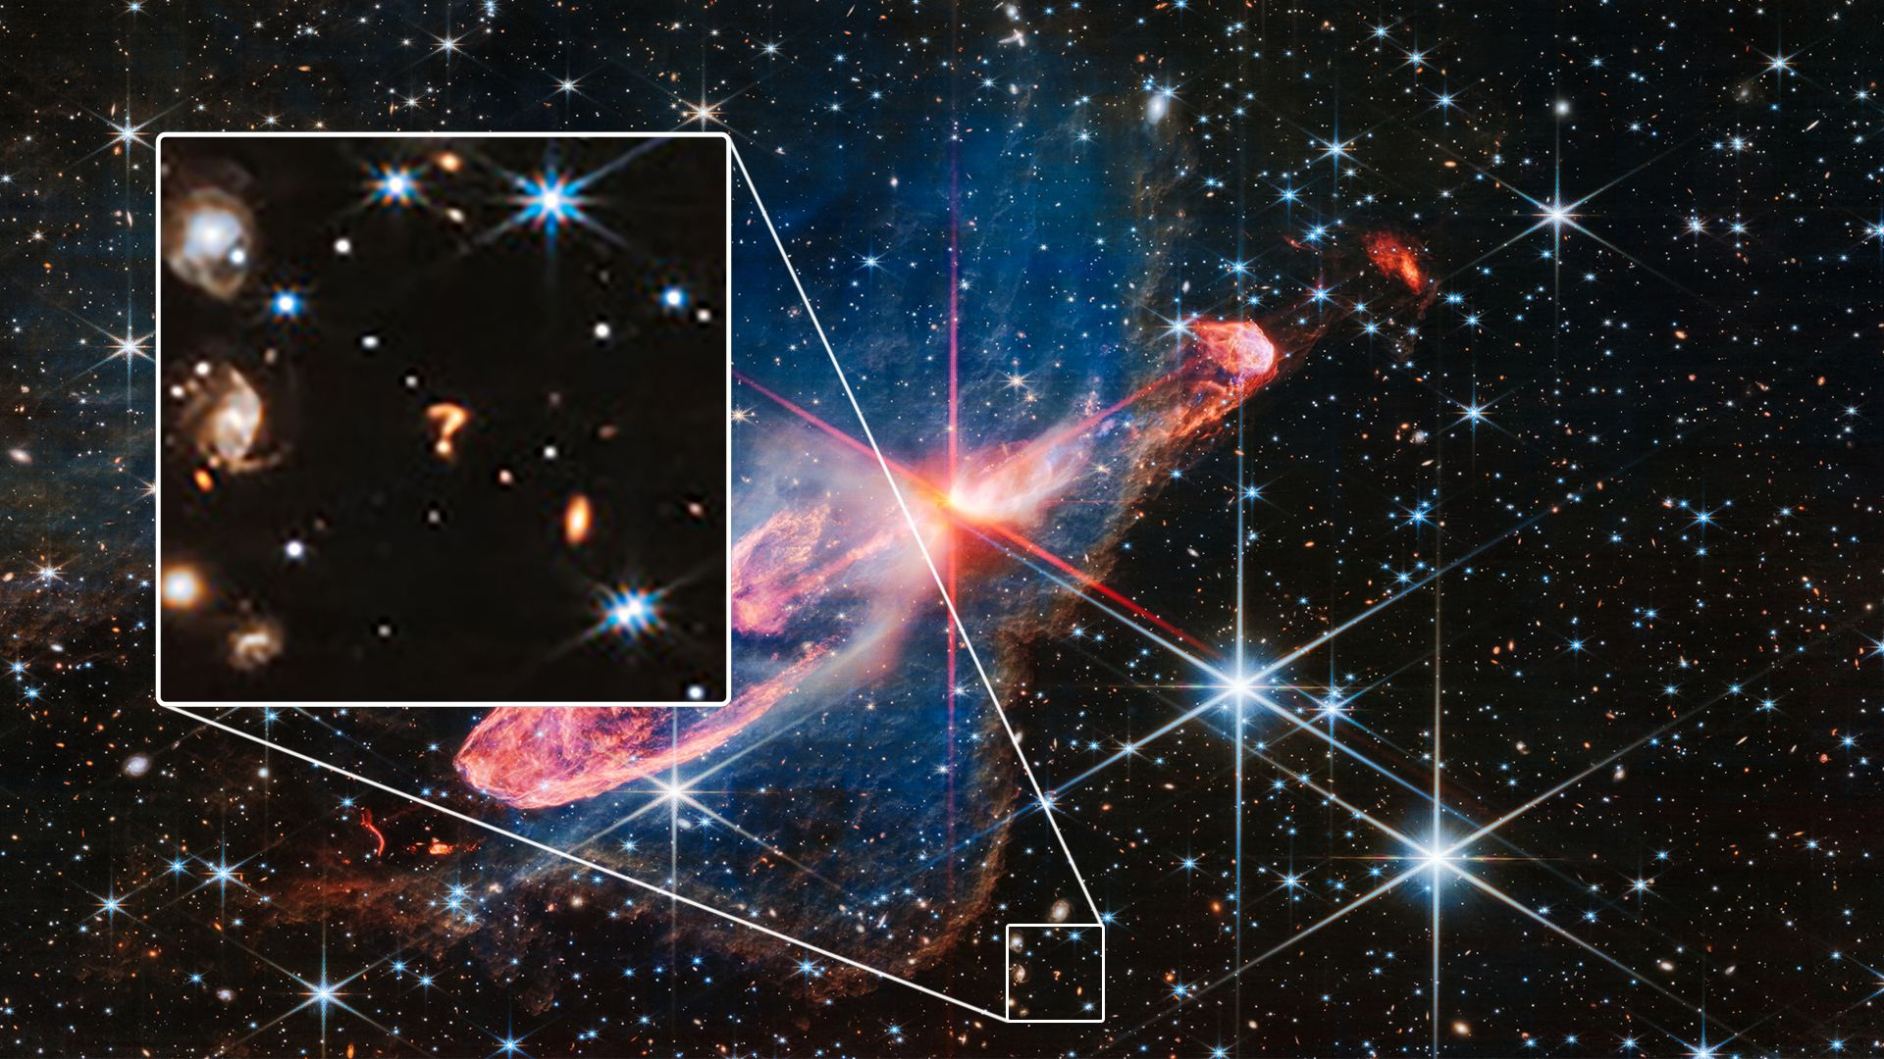
Questions?

